Slide 1
Data Analytics Capstone
BOOK RETAILER ANALYSIS
Maddi Klepps

Slide 2


WELCOME!
My name is Maddi Klepps and I am an Fox Valley Technical Student majoring in Data & Analytics. This is my capstone project analyzing best-selling Amazon book data to recommend products for an online book retailer!
2

Slide 3

Table
OF CONTENTS
1. PROBLEM STATEMENT
2. DATASET
3. KEY FINDINGS
4. LIMITATIONS
5. RECOMMENDATIONS
6. BUSINESS VALUE
- HIGHEST GROSSING GENRES
- HIGHEST GROSSING SUBGENRES
- TOP PRIORITY TITLES
- TOP PRIORITY SERIES
- TOP PRIORITY TITLES WITHIN A SERIES
3

Slide 4

PROBLEM STATEMENT
What bestselling books should an online retailer prioritize to maximize revenue and customer engagement?
Understanding customer purchasing trends such as high performing genres, titles, average ratings and other variables gives insight into what products customers WANT. Utizling data to backup these claims creates a strong business plan.
4

Slide 5
VARIABLE | DESCRIPTION
Genre | Primary Category
Subgenre | Secondary Category; more detailed description of contents
Title | Invidivual book title
Series | Book series or franchise
Final Price | Retail book price at time of dataset pull
Review Count | Number of customer revies on Amazon listing; used to display customer engagement
Revenue | Derived metric; final price * reviews
Priority Score | (Standardized revenue * 0.6) + (Standardized engagement * 0.4)
DATASET
The data used in this analysis is from Amazon’s best-selling books list from 2021.
Why Amazon?
Since this business is online based, utilizing data from another online based retailer ensures consistency among customer purchasing patterns.
What does the dataset include?
2200+ lines, each representing a book
Genre, reviews, ratings, price, series, etc.
Source:
https://github.com/luminati-io/Amazon-popular-books-dataset
5

Slide 6


KEY FINDINGS
Data-driven findings detailing different parts of the dataset to answer the problem statement.
6

Slide 7
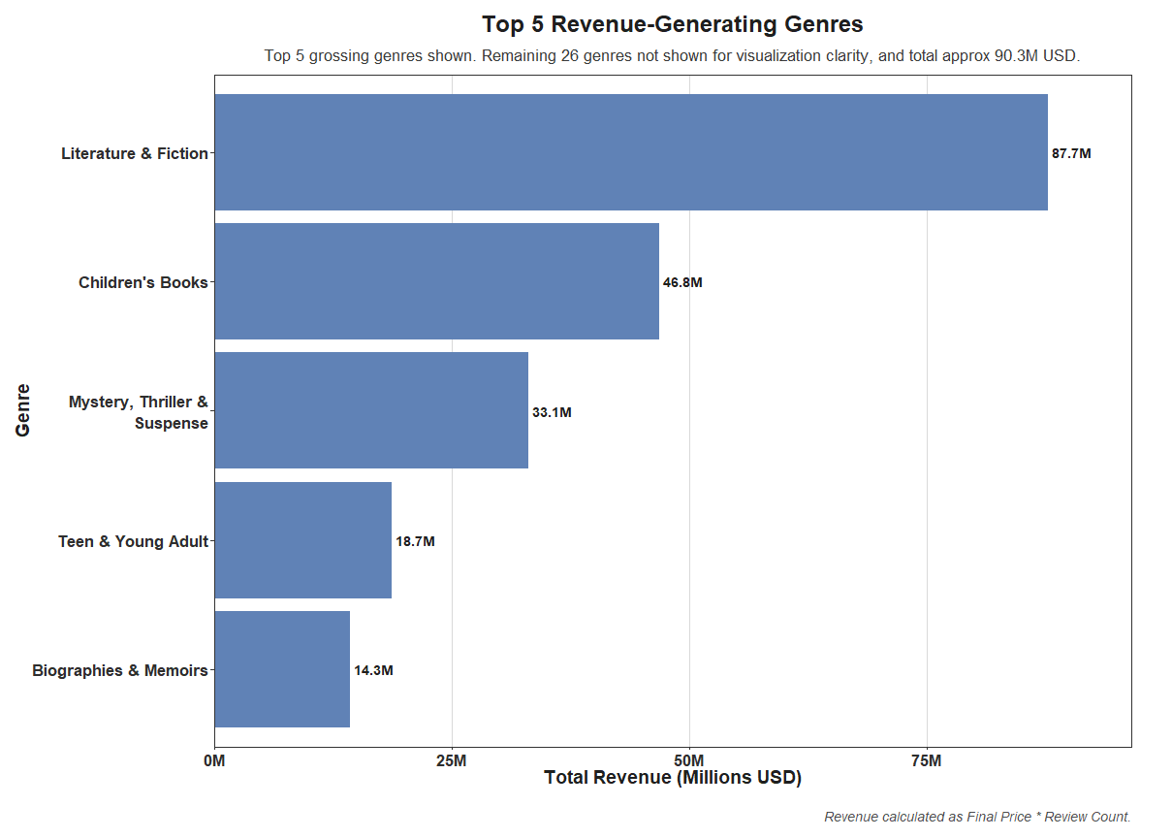
HIGHEST
GROSSING
GENRES
Fiction is the highest grossing genre, followed by Children’s Books, Mystery/Thriller, Teen & Young Adult and Biographies & Memoirs.
Key Takeaways:
Fiction dominates
Children’s Books outperform most non-fiction genres
7

Slide 8
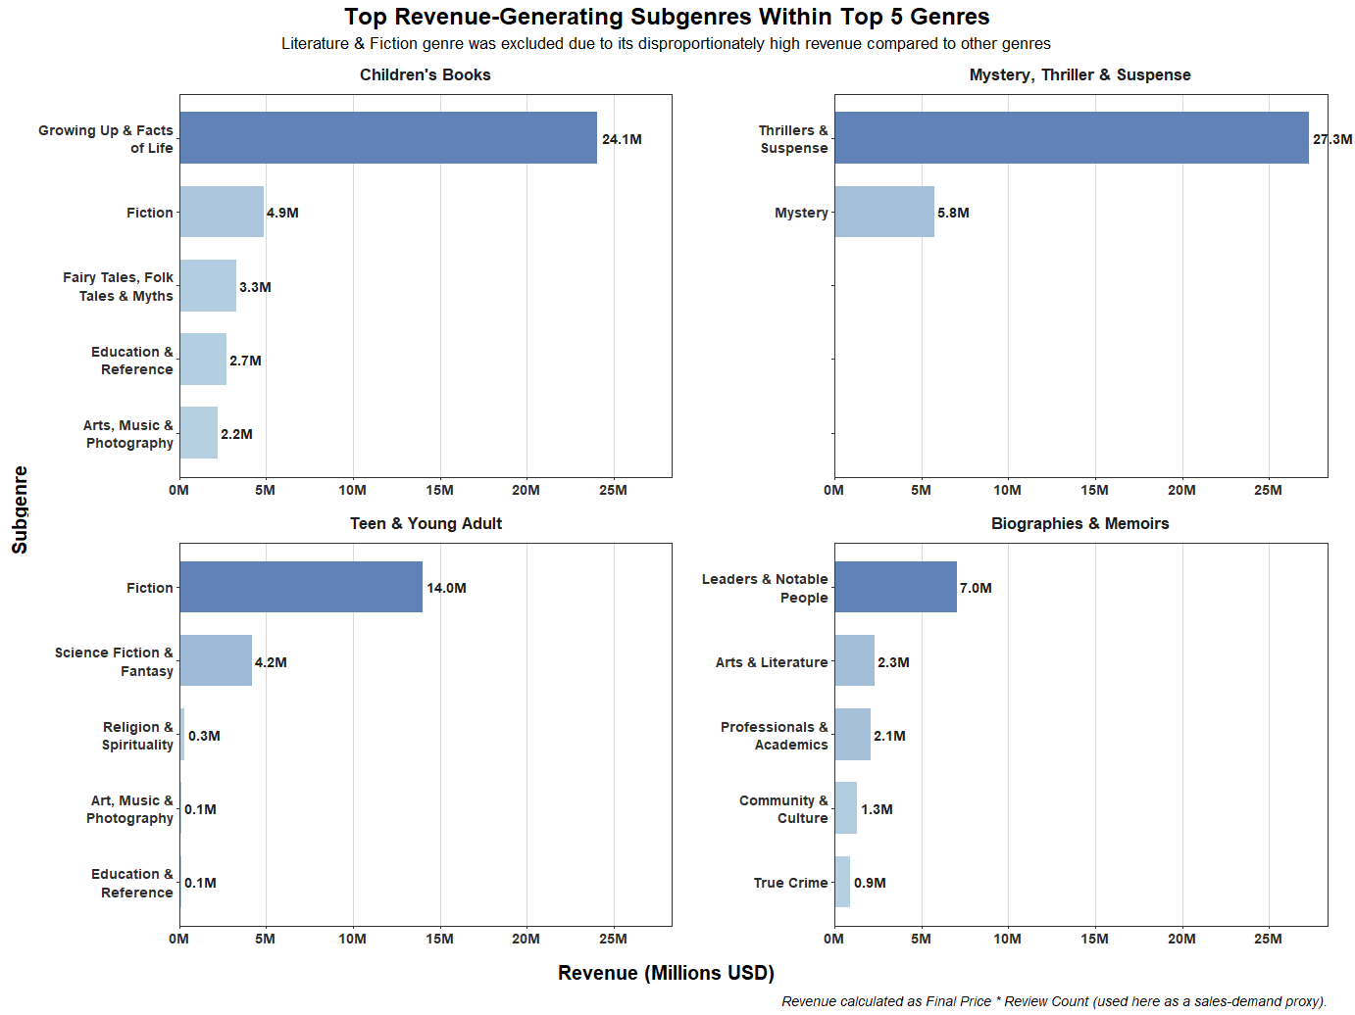
HIGHEST
GROSSING
SUBGENRES
Subgenre revenue contributions within each top performing genre.
Displayed with gradient for quick contribution comparison.
Key Takeaway:
Subgenre performance varies drastically within a genre
8

Slide 9
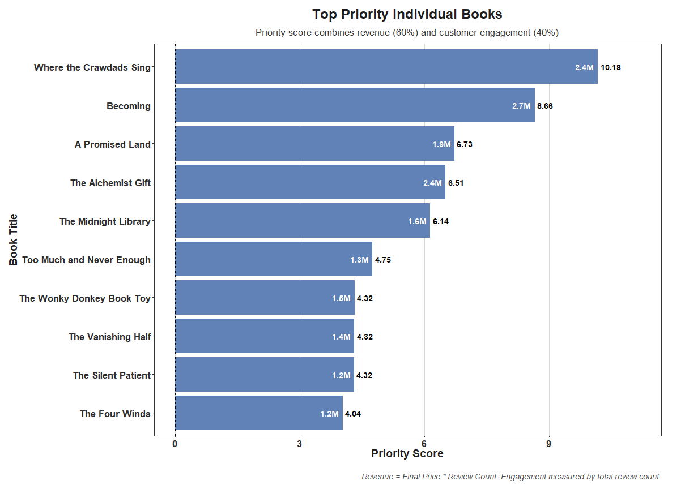
TOP PRIORITY TITLES
Top 10 prioritity individual titles determined by Priority Score, a measure of revenue & customer engagement.
A high priority score indicates a high grossing title with a high number of reviews.
Key Takeaway:
Customer engagement & revenue create tangible evidence for what to stock
9

Slide 10
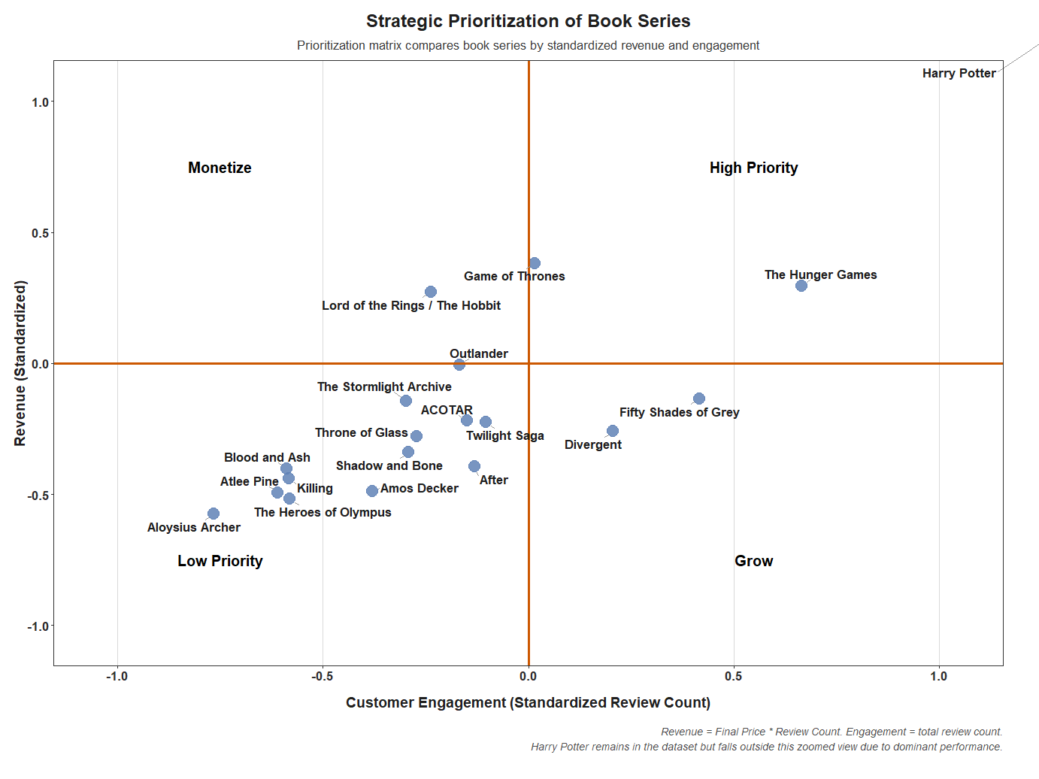
TOP PRIORITY SERIES
High Priority
high grossing & high customer engagement
should be high on inventory list
Grow
mid to high customer engagement with mid revenue
create buzz around titles for high potential
Monetize
high grossing but mid customer engagement
price higher for niche consumer base
Low Priority
lower customer engagement & revenue
keep but don’t priorize over other titles
10

Slide 11
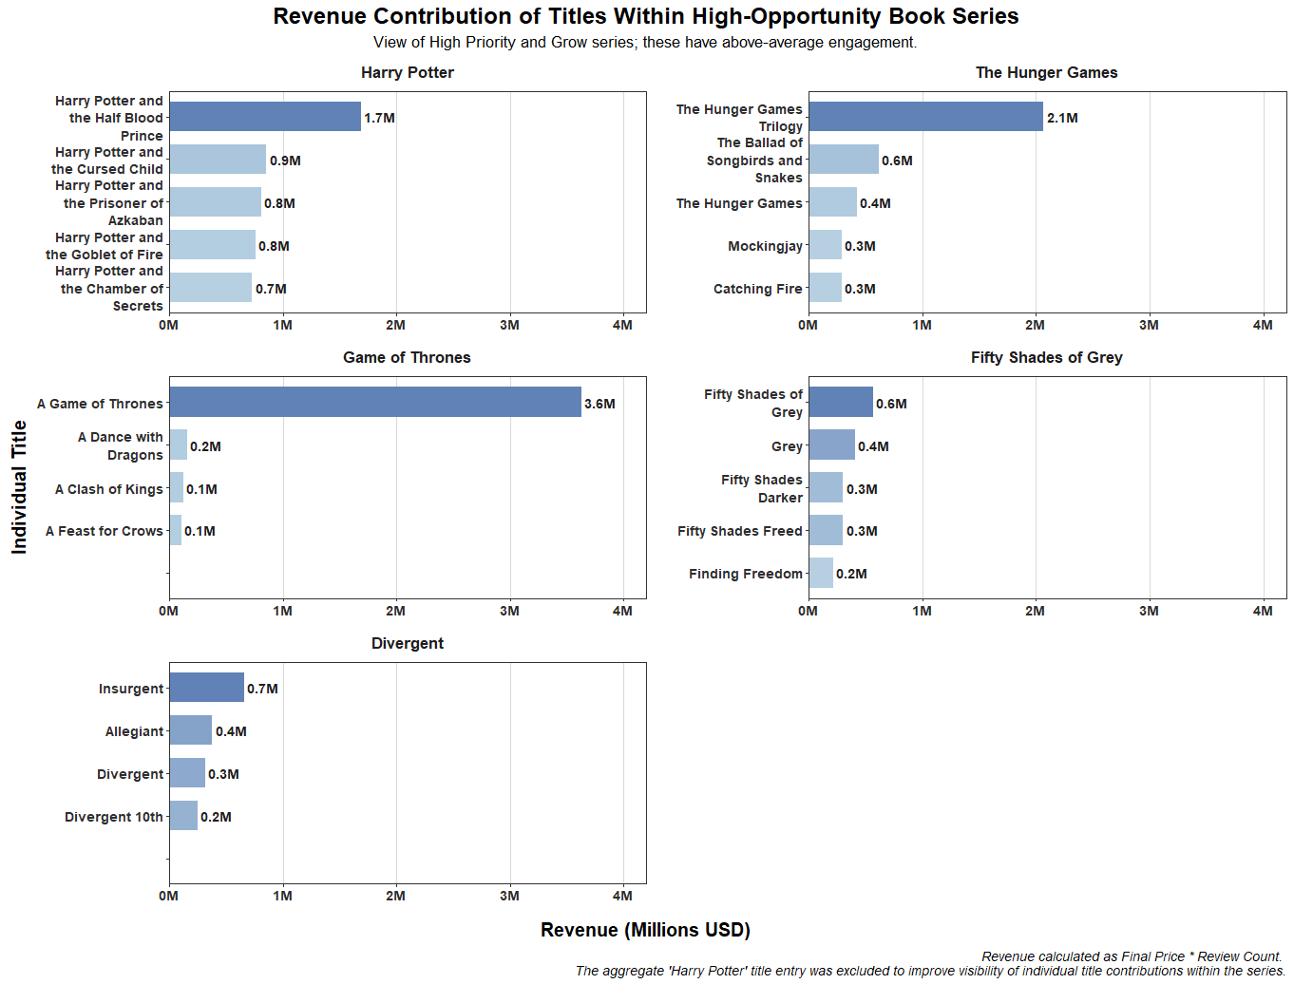
TOP TITLES WITHIN A SERIES
Top individual titles’ revenue contributions within series in the High Priority and Grow quadrants.
Displayed with gradient for quick contribution comparison.
Key Takeaways:
Customer engagement helps identify scalable series
Individual titles help determine stock of series
11

Slide 12

LIMITATIONS
Revenue is not guaranteed, only projected.
Revenue is calculated based on final price the book sold for and the number of reviews left. Because of this, the revenue cannot be guaranteed, but gives a good indication of how it performed.
The data cannot relay exactly what to stock.
The data will not spell out exactly which titles to stock, however trends of revenue and customer engagement can be used to predict top performing titles & products. Emphasizing customer engagement gives insight into what the consumer enjoys and is reaching for, indicating these should be stocked.
The data is not the most current.
This dataset was provided from Amazon’s best-sellers list for 2021 and was the most up-to-date version available for public usage. Because of this, its very possible titles identified within this presentation have been surpassed by different titles.
12

Slide 13
RECOMMENDATIONS - GENRE SPECIFIC
Prioritize Fiction titles
Keep a large inventory of Children’s Books, Mystery & Thriller, Teen & Young Adult, and Biographies & Memoirs titles
Within each genre, stock titles falling into the highest grossing subgenres
Stock books from all subgenres to appeal to niche customers
13

Slide 14
RECOMMENDATIONS - TITLE/SERIES SPECIFIC
Prioritize titles off of the Top 10 Priority Books list
Prioritize series in the High Priority and Grow quadrants of the Prioritization Matrix
Keep in mind titles in the Monetize quadrant
Prioritize top performing titles within a series
14

Slide 15

BUSINESS VALUE
Increased inventory efficiecy
Higher projectred revenue potential
Improved promotional targeting
Positive customer engagement & retention
15

Slide 16

THANK YOU!
Maddi Klepps
Data Analytics Capstone
Spring 2026

